Slide 1


The Golden 4 Formulas To Grow Your Ecommerce Company

Slide 2


Handcuffed by your own numbers
Shackled by your numbers
www.wickedreports.com

Slide 3

Throwing darts in the dark...
With all the numbers at your fingertips, what do you actually follow?
www.wickedreports.com

Slide 4

Data is only raw material
Data itself is just oil in the ground.
It sits there.
There’s lots of it.
But it’s meaningless on its own.
www.wickedreports.com

Slide 5

But you can leverage raw material for power
How do you make use of a raw material?
You mine it.
Hence data mining.
Refine your “oil” and make informed decisions that grow your company.
www.wickedreports.com

Slide 6
Introducing...
The Golden 4 formulas
to grow your
ecommerce company

Slide 7

Formula
1
Lifetime Value (LTV)
LTV = Revenue / Customer Count
www.wickedreports.com

Slide 8
Lifetime Value (LTV) Example
LTV = $1 million / 5k Customers
LTV = $200
www.wickedreports.com

Slide 9

Formula
2
Return on Investment (ROI)
ROI = (Revenue - Costs) / Costs
www.wickedreports.com

Slide 10
Return on Investment (ROI) Example
ROI = (Revenue - Costs) / Costs
ROI = ($1 million - $500k) / $500k
ROI = 1.00
ROI = 100%
www.wickedreports.com

Slide 11
Return on Investment (ROI) Example / Wrong
ROI = Revenue / Costs
ROI = $1 million / $500k
ROI = 2.00
ROI = 200%
www.wickedreports.com

Slide 12

Formula
3
Average Time to 1st Purchase
AVG = Date of 1st Purchase - Date of New Lead Opt-in
*Calculate all amounts, then take the average
www.wickedreports.com

Slide 13
Lifetime Value (LTV) Example
TIME = ( November 5th - October 1st)
*Calculate all amounts, then take the average
36 days, 38 days, 27 days, 35 days, 20 days
AVG = 31.2 days
www.wickedreports.com

Slide 14

Formula
4
Earnings Per Lead (EPL)
EPL = Revenue / Lead Count
www.wickedreports.com

Slide 15
Earnings Per Lead (EPL) Example
EPL = Revenue / Lead Count
EPL = $1 million / 20k Leads
EPL = $50
www.wickedreports.com

Slide 16
Why aren’t you tracking these already?
www.wickedreports.com

Slide 17


You have tons of data
It’s a lot of math
You don’t have a team of data scientists
Your attention is pulled in 10 other directions

Slide 18

What if you could set it and forget it?
www.wickedreports.com

Slide 19

Wicked Reports takes your raw data across ALL channels and mines it - automatically - so you have insight at your fingertips.
Your oil becomes your rocket fuel.
www.wickedreports.com

Slide 20


Finally, break free from the shackles.
Finally, use the numbers to your advantage.
Finally, know what to trust, what to track, and what to turn into action.

Slide 21
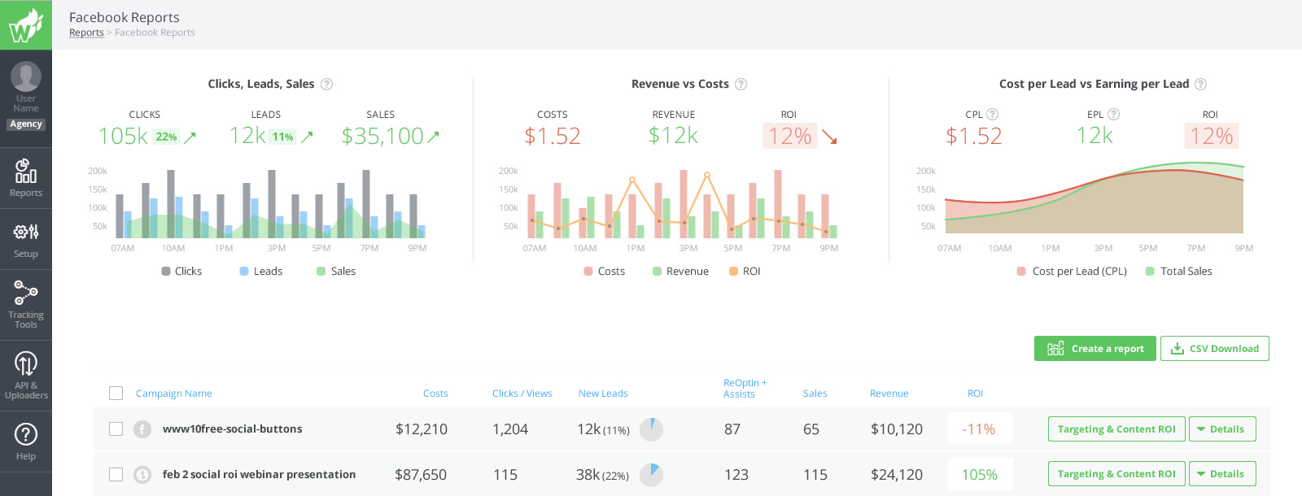
Interested? Get a demo to see exactly how Wicked Reports can help your business grow faster.
wickedreports.com/demo
www.wickedreports.com

Slide 22
Download the free webinar now!

